Slide 1
Financial Literacy:Building a Secure Financial Future
Japheth Jev, M.Sc, ACA,CIMA,CGMA,FHEA,PGCE
Lecturer in Finance and Accounting, Birmingham Newman University

Slide 2
Content
Introduction
Setting Financial Goals
Budgeting,Saving, and Investing money
Creating Income Streams via Side-hussle
Conclusion
Q & A

Slide 3
Introduction

Slide 4
The Stark Reality!
The World population is today is about 8.23b people (www.worldmeters.info).
However, ONLY 33% of these population is financially literate ( S&P Global Financial Literacy Survey, 2014).
Financial literacy means ability to make informed decision about savings, investing, borrowing, and more (WorldBank,2023)
Financial ignorance undermines a person’s ability to prosper and achieve a stable financial-wellbeing.
Everyone who aspires to achieve a stable financial-wellbeing must acquire financial literacy.
This presentation will help you to acquire financial literacy by sharing the practical steps you need to take to overcome financial ignorance.

Slide 5

Setting Financial Goals
………a pilot without bearing will crash land the plan

Slide 6
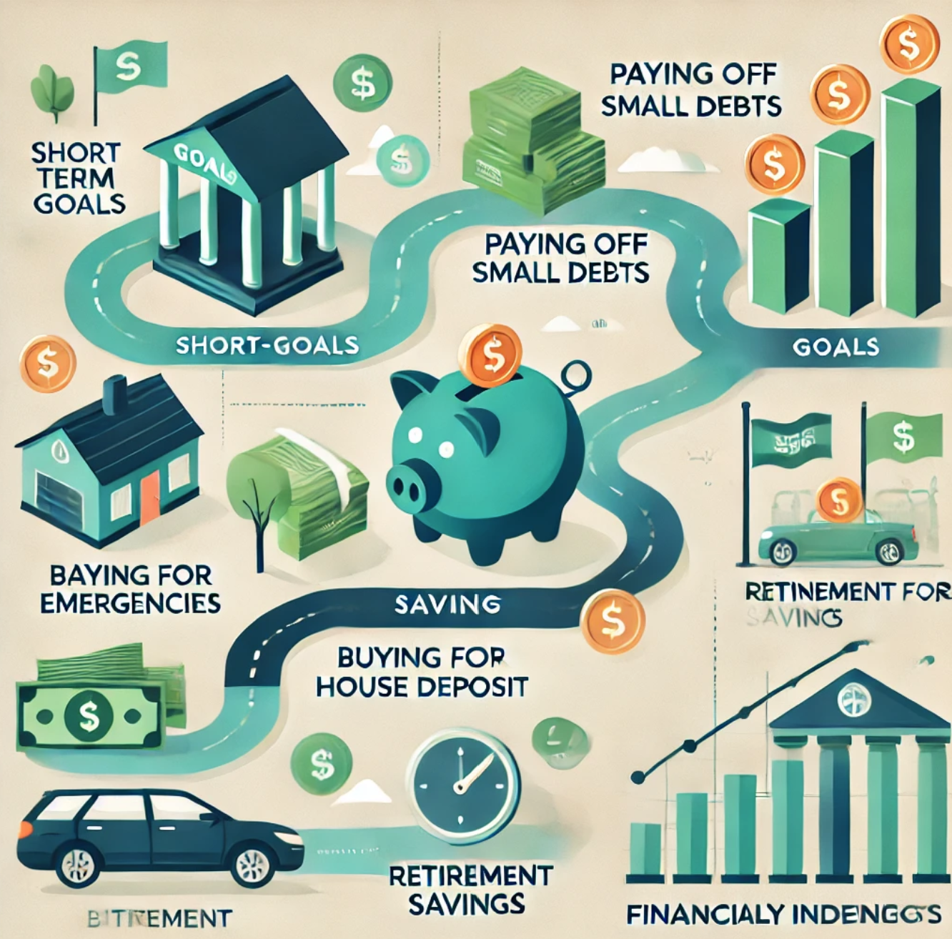
What are financial Goals?
Diversifying your retirement plan is essential; not optional.
Your specific measurable objectives that guide how you manage your money to achieve short and long term financial success.
There are two types- Short term and long term
Short term takes you less than 3 years to achieve.
Examples: Paying off your credit card debt, buying a car, saving for vacation, saving for birthday party

Slide 7
What are financial Goals?
Diversifying your retirement plan is essential; not optional.
Long term goals-these take you more than 3 years to achieve.
Examples are: saving to buy a house, pursuing a degree, building a side business, sponsoring children in school, etc
Make sure your goals are specific, measurable, and time-bound.
Write down your financial goals on your vision Board!

Slide 8
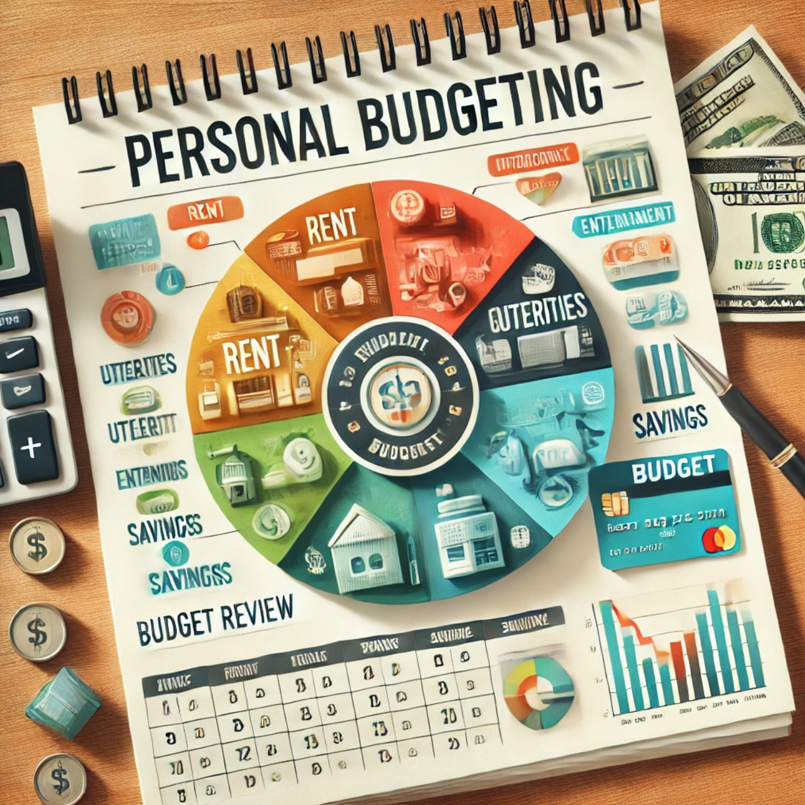
Budgeting,Saving and Investing
A budget is a written plan on how you will make money and spend it.
A budget helps you to organize your finances and control expenses hence save money.
Use a budgeting tool like Snoop ( https://snoop.app/) or budget app attached to your mobile banking app.
For US resident use everydollar (https://www.ramseysolutions.com/ramseyplus/everydollar) for your personal budgeting.

Slide 9

Savings and Investment
You need to set aside an amount of money every month from your income to invest.
Use the 50/30/20 rule
50% for essentials-rent/mortgage, health,clothing,food, transport.
30% for lifestyle – entertainment, dining out, vacation, shopping, etc
20% for savings- emergency fund, retirement, startup capital,equity for mort
Operating margins have improved, signaling operational efficiency, while strengthening our reserves.
This underscores our commitment to financial stability, positioning us for sustained growth.

Slide 10
Investing
Savings alone does not help you to grow wealth!
You do not get rich by saving money; you become richer when you save and invest.
Investing means putting your savings into an asset that could earn returns.
Different assets to put your savings to:
Stocks/shares
Start a business
Buy real estate property
Buy commodities like yams, gold, crude oil, soyabeans, etc
Investing in any of these assets creates both risk and rewards- the risk is you may lose your money, and the reward is you may gain more money.

Slide 11
Available Stock Investment Options
Exchange Traded Fund (ETF)
Investment Account
ETF is a bucket of stocks of diverse companies in the stock market.
ETF is regulated by the Financial Conduct Authority (FCA) to protect investors.
The fund managers are experts who select the stocks to add to ETF so you do not need to be an expert to invest in stocks
Good examples of ETF are:
- ABRDN All Shares Tracker Fund
Vanguard S&P500 UCITS ETF
Open investment account with one of the FCA licensed brokers to start:
Halgreaves Lansdown (www.hl.co.uk)
IG Brokers (www.ig.com/uk)
NB: Profit made from investment in ETF is subject to tax annually.

Slide 12
Available Stock Investment Options
Stock/shares ISA
Investment Account
ISA: Individual Savings Account
Money invested and profit earned is free from tax- not taxed.
Maximum amount you can invest in a year is £20,000- may change over time.
Minimum amount of £100 to start- may invest minimum of £25 monthly.
- You can use the money saved in ISA to buy stocks and ETF tax free.
HSBC Stock and shares ISA(www.hsbc.co.uk/investments/isas)
Barclays Investment Account(www.barclays.co.uk/smart-investor)
Halgreaves Lansdown ISA (www.hl.co.uk)
NB: Profit made from investment in ISA account is tax-free. You can save thousands of pounds in tax by investing through ISA account.

Slide 13
Available Stock Investment Options
Fund Manager’s Account
Investment Account
You will open investment account with etoro
Put your transfer the funds you wish to invest into your account
Sign fund manager contract with GreenFinance capital
Provide log in details to fund manager’s to invest the funds on your behalf.
- You pay no fees if the fund manager did not make money for you.
Open investment account with Etoro (www.etoro.com) for Europe and America
Barclays Investment Account(www.barclays.co.uk/smart-investor)
Halgreaves Lansdown ISA (www.hl.co.uk)
NB: Profit made from investment in ISA account is tax-free. You can save thousands of pounds in tax by investing through ISA account.

Slide 14

Debts and Credit Cards

Slide 15
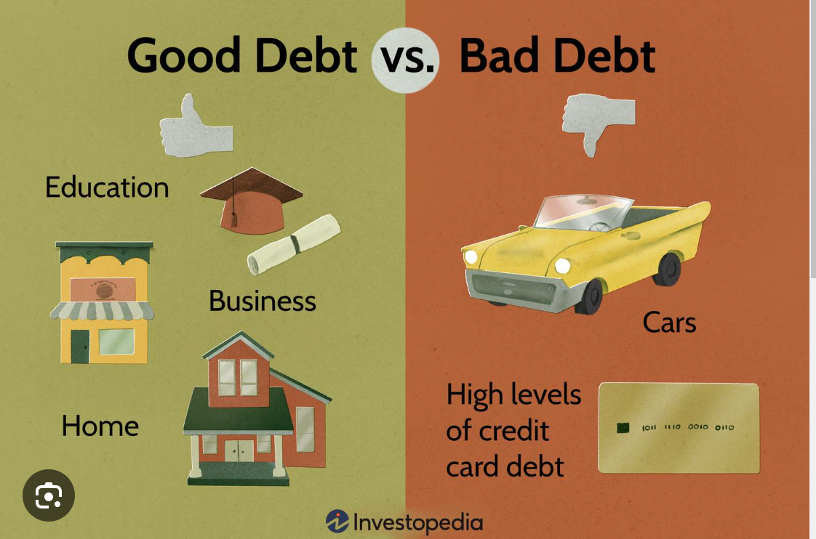
Debts & Credit Cards
Green supply chain
Reduced carbon footprint
Waste reduction
Water conservation
Not all borrowings are bad; borrowing to put the money in assets that earns you more money is good debt.
But borrowing to pay expenses is bad debt because it encourages overspending which badly affects your ability to save money.
Taking a credit card is a good debt if it could be used to help you build a good credit score.
If you take a credit card, make sure you pay back monthly to avoid building high debt which could damage your credit score.
A good credit score can open doors for you to get good debts like mortgages, loan for education, loans to start a business from the bank, etc

Slide 16

Starting a Personal Business
It is very difficult to be financially stable if you depend only on salaries and wages from a job.
Everybody wants to be rich but not everyone wants to take a risk to start a business.
You can have a business by the side while you working in your 9 – 5 job.
However, you can resign to face your business after nurturing it to a level of growth and certainty.
There are many business opportunities that can fit into your normal 9-5 job.
Source: AI Generated image, 2025

Slide 17
Examples of Businesses to Start
Dropshipping with Amazon,ebay,shopify
Start a consulting business in your area of expertise- Academics, medicine, IT, Finance, engineering,
Home made popcorn- order pocorm making machine at aliexpress.com
Make and sell cupcakes on food delivery apps like uberEat.
Start weekend and evening delivery partner business with Amazon.
Makes and sale courses in your field on udemy.com and reeds.co.uk
Import stuff from China and sell them on Amazon and ebay.
Train and acquire new skills in emerging fields like cyber security, AI, mental health, fitness coaching where you will start consulting.
Import African foods and sell on Amazon foodshop online.

Slide 18

Conclusion
Financial literacy is key to financial success in life.
To attain financial freedom, you have to set personal goals, cut your spendings, save, invest, and manage your debts.
Starting a business along side your 9-5 job is great if you wish to attain financial success.
There are many small businesses you can start along side your 9-5 job.
Source: AI Generated image, 2025

Slide 19
Questions & Answers

Slide 20
Thank you
Japheth Jev, M.Sc, ACA,CIMA,CGMA,FHEA
Japheth.jev@staff.newman.ac.uk

